Slide 1


MAKE YOUR PROPERTY PROFITABLE

Slide 2
Problem Identified
“
Owning commercial property can be expensive. What is the best usage of my property to maximize profitability?
The PropertyUsage score instantly recommends best use for the property based on data, and breaks down why.
Notes:
It’s a fact that owning commercial property can be very lucrative... however, when the property is vacant, it can become a very expensive liability. Some of the costs are taxes, insurance, security and maintenance costs for the inside and outside of the property. If the investor doesn’t live in town, they may also pay a property management company to take care of the property. A property is only profitable when it is used, and it is the most profitable when it is used optimally.

Slide 3
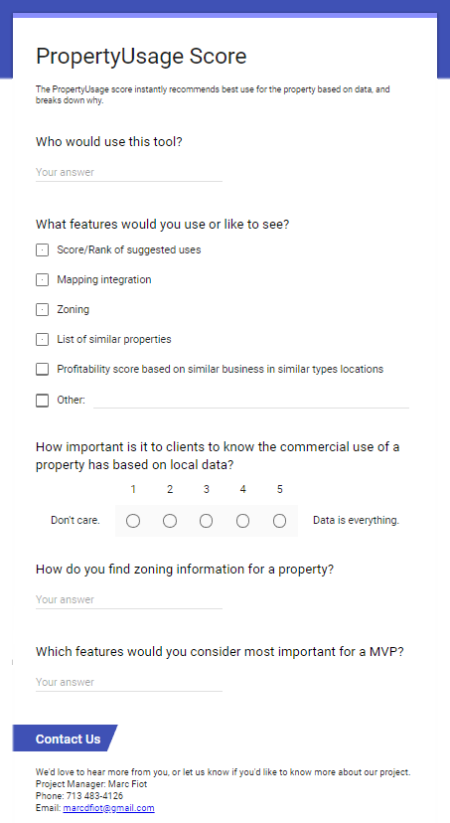

Business Decision Makers
Commercial Real Estate Property Owners & Brokers
+
Real Estate Investors
Notes:
If a business decision maker wants to buy a new commercial property they get a quick view of the best uses for that particular property. If they want to sell or lease their existing property, they can use the PropertyUsage detailed information to help them market to prospective buyers, PropertyUsage will recommend possible uses for the property and show the data behind its recommendation

Slide 4



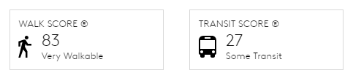
Competition and Existing Alternatives
Alternatives:
ArcGIS Business Analyst
Maptitude
Similar Products:
Walk Score
(Including Transit Score)
Notes:
The good news is that there is no existing score for recommending development possibilities for your property. There is a Walk Score, Bike Score and Transit Score. The purposes of these scores is to let the person looking at a particular property get an idea of how easy it is to walk, bike or use public transportation in those areas. Our product is in some ways comparable to GIS software used site selection software such as Esri and Maptitude. However, we take a bottom up approach, designing a product that is accessible for those looking for information on a particular property, whereas those products take a top down approach, as tools to find an ideal location. Our product is also comparably much easier to use, as site selection software often involves compiling the data yourself, and is often complex with a high learning. Whereas our product instantly puts the data at the fingertips of our user.
We feel that the PropertyUsage Score will fit right in next to those existing scores on various commercial real estate websites. We even have ambitions of marketing our product to Commercial Real Estate listing companies such as CoStar, placing our scores alongside property listings would create value for both sellers and business decision makers looking to buy a property.

Slide 5




Impact
Saves Time
Easy to Use
Inexpensive
Innovative
(ML)

Slide 6
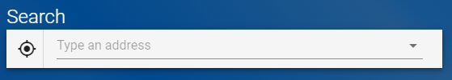
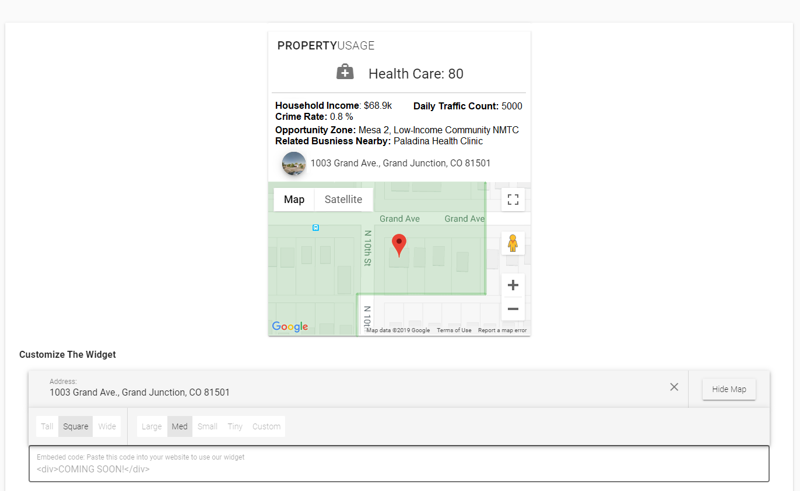
Implementation
Demo the API on our homepage with address search or current location.
Simple interface on our website
Embeddable widget
MVP only makes recommendations about broad categories
Example of the widget builder, and returned results.
Notes:
Data and recommendations available are available by a simple interface on our website. We also have an easily embeddable widget which allows integration on property listing pages and websites. Our recommendations can also Can also be accessed via API for integration into other applications. Our minimum viable product only makes recommendations about broad categories of businesses, for example healthcare, we hope in the future to be able to make more specific recommendations.

Slide 7

Datasets
Colorado Data:
Business Entities
Population Projections
Enterprise Zones
Opportunity Zone
Crime in Colorado from 1997 to 2015
Degrees by Institution
Personal Income
Road Traffic Counts 2014-2017
Highway Traffic Counts 2014-2017
All Restaurants in Colorado
GIS:
Mesa County Zoning
BBB:
OpenAddresses for Mesa
Notes:
As you can see we have utilized several datasets combining and analyzing them all together to aid in coming up with with a property usage.

Slide 8
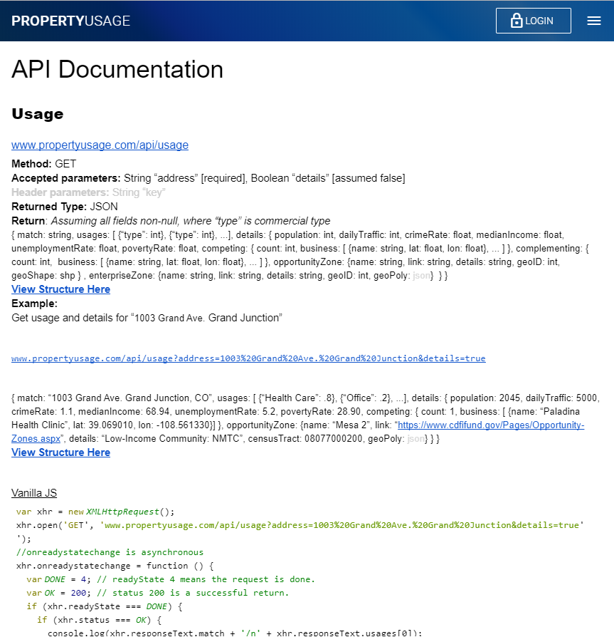
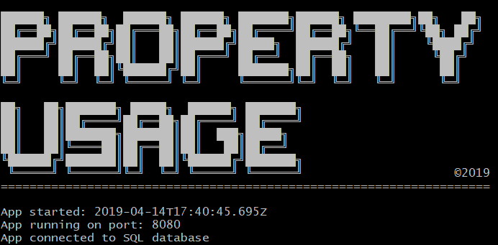
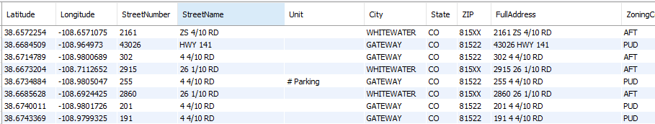
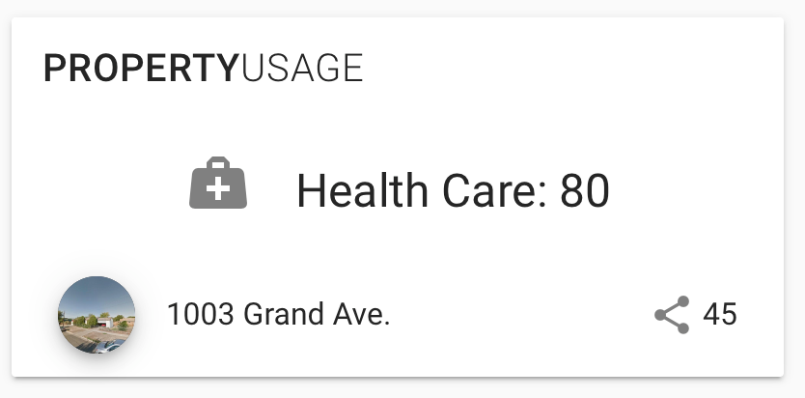
Data
A Python machine learning algorithm takes into account all the datasets and provides a recommendations accessible through a widget or our API.
Notes:
From these data sets we returned through our API the suggested use based on all of these datasets with filters and machine learning, we aslo return key details about the location such as crime, traffic, average income, opportunity zones and enterprise zones.

Slide 9
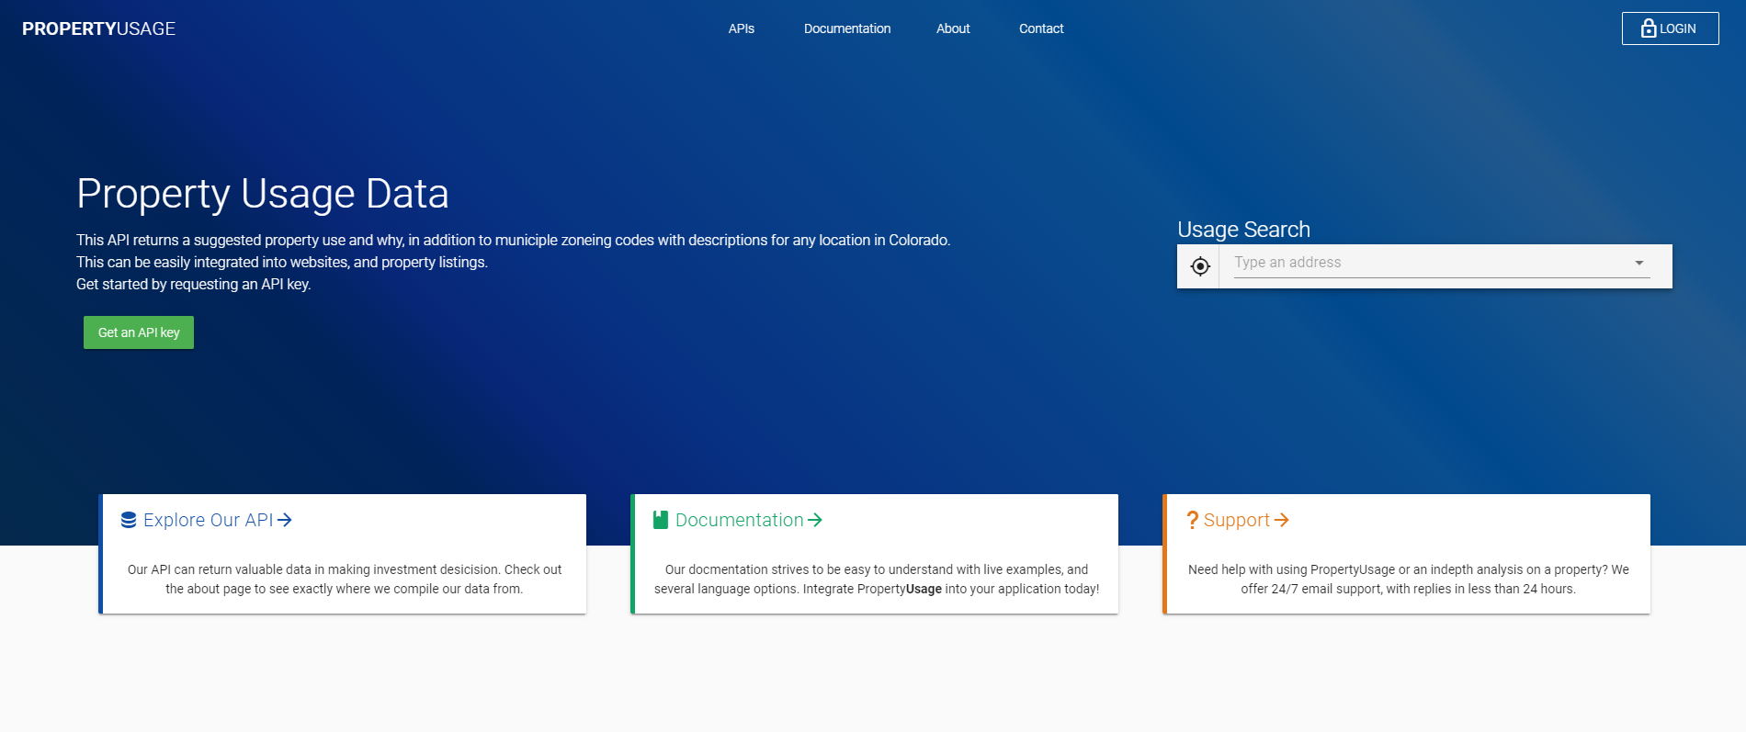
Results
Notes:
Currently, our software only works for addresses in Mesa County, we hope to expand

Slide 10





Our Team
Adam Childs
Marc Fiot
Aaron Clymer
Leo / Meng Luo
Dax Hurley
Software Developer
Software Architect
Software Engineer
Data Scientist
Graphic Artist

